Slide 1
Yield Spreads
Yield spreads are the differences in yields between risky bonds and default free U. S Treasury bonds of similar maturity
(Yield Spread)_{t} = ( Yield on Risky Bond)_{t} – Yield on a U.S treasury bond)_{t}

Slide 2
Term Structure of Interest Rate Theories
The relationship at a point in time between the YTMs of homogeneous bonds and the years to maturity for the bonds, holding other things constant, is called the term structure of interest rates or Yield Curve.
The interest rate charged depends on the length of time that the funds are held, is the basis of term structure theory.
The Expectations Hypothesis- The expectations approach to the term structure of interest rates states that long term interest rates are the geometric mean of expected forward short term interest rates

Slide 3
Yield Curve
Yields are plotted as a function of maturity date.
7
6
5
4
95 97 99 01 03 05 07 09 11 13 15 17 19 21 23
Years

Slide 4
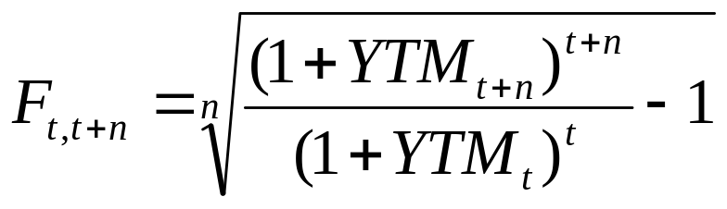
The Expectations Hypothesis-
The Expectations Hypothesis- The expectations approach to the term structure of interest rates states that long term interest rates are the geometric mean of expected forward short term interest rates.
F_{t,t+n}=The expected forward rate on a bond maturing n periods after the start of the period t

Slide 5
Problem
The following yield structure was in existence on August 31, 19X9, determine the missing forward yields
Year | Forward Rate | YTM
1 | 7.00% | 7.00%
2 |  | 7.50%
3 | 9.77% | 8.25%
4 |  | 8.50%
5 |  | 9.00%

Slide 6
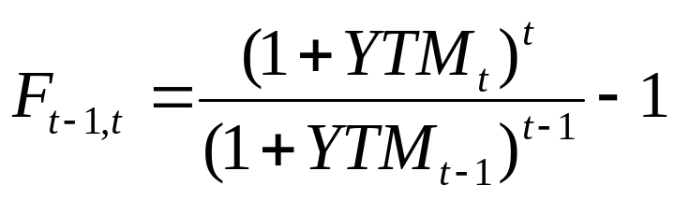
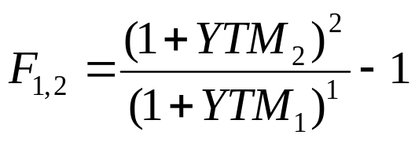
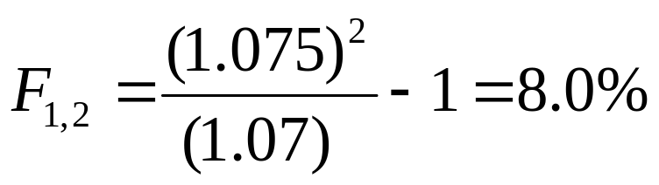
solution
By using equation
The expected 1 year forward rate for year 2 is

Slide 7
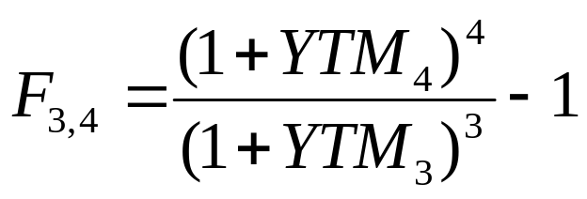
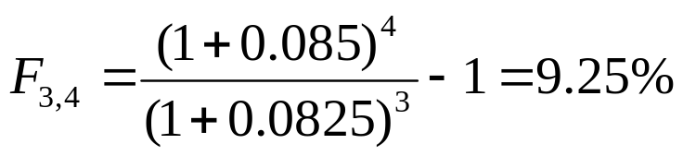
solution
For year 4, the implied 1- year forward rate is

Slide 8
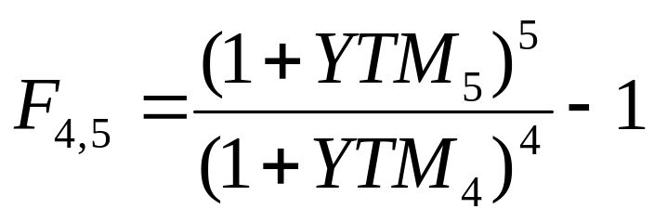
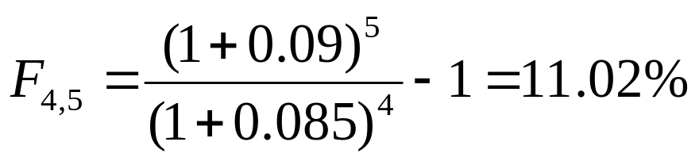
Solution
For year 5, the 1 year forward rate is

Slide 9
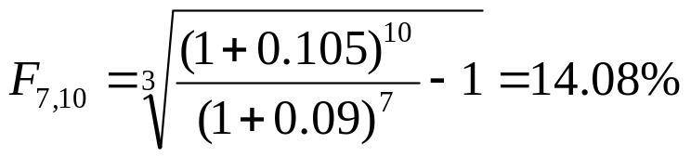
Problem
The YTM on a 7 year T bond is 9.0% and the YTM on a10 year T bond is 10.5%. Determine the implied average forward rate for a 3 year T bond starting in year 8

Slide 10
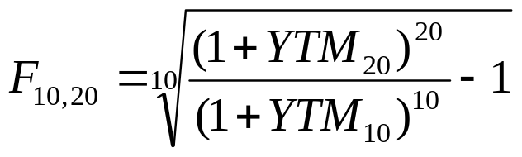
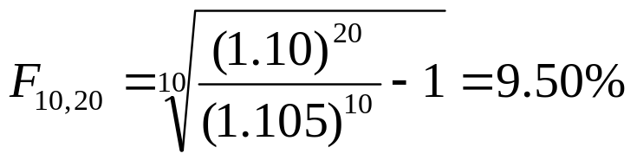
Problem
If the YTM on a 20- year T bond is 10% and similar 10 - year T bonds are yielding 10.5%. What is the rate on a 10 - year T –bond starting in 11?

Slide 11
Problem
The following two $1000 face value zero coupon bonds are available.
Bonds Price Maturity
ABC $900 1 Year
XYZ $785 2 Year
Show How the forward rate starting in year 2 could be locked in by a Bond trader.

Slide 12
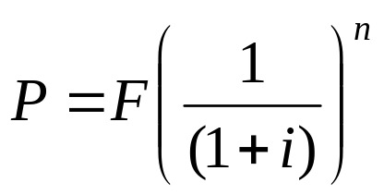
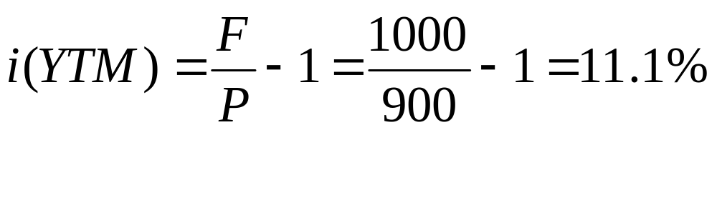
Solution
Finding the YTM for ABC Bond .
Finding the YTM
P=F(P/F,i%,N)=

Slide 13
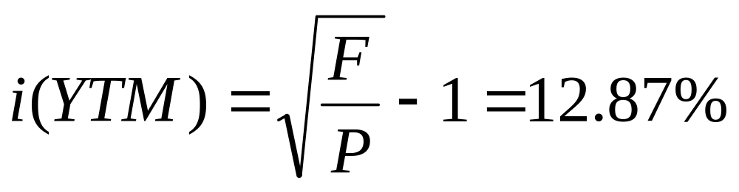
Solution
Finding the YTM for XYZ Bond .
Finding the YTM
P=F(P/F,i%,N)=

Slide 14
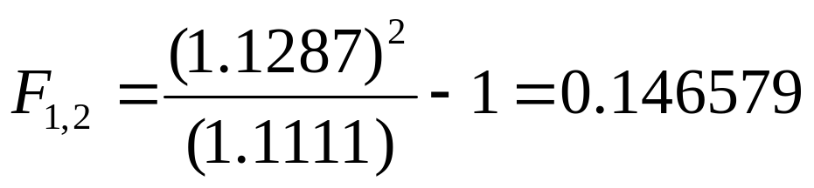
Solution
Calculating the Forward Rate for year 2 is

Slide 15
Solution
Locking the forward rate in the year 2.
Sell the 1 year Bond short for $900 and purchase ($900/$785) 2 year bonds with the proceeds.
At the end of year 1, when the 1 year bond matures $1000 must be spent to cover the short sale
At the end of 2 year (1.1465 * 1000) will be received when the 2 year bond matures
The $1000 outflow in year1 and $1146.50 inflow in year 2 produces a $146.50 gain. This is a return of 14.65 % in year 2.

Slide 16
Spot Rates
Spot rates are the basic interest rates defining the term structure. The spot rate s_{t} is the rate of interest, expressed in yearly terms, charged for money held from time( t=0) until time t.
Both the interest and the original principal are paid at time t
a) Yearly – Under the yearly convention the spot rate s_{t} is defined such that (1+ s_{t} )^{t} is the factor by which the deposit held t years will grow.
b) M Periods per year – Under a convention of compounding m periods per year the spot rate s_{t} is defined so that (1+ s_{t}/m )^{mt}
c) Continuous Under a continuous compounding convention, the spot rate s_{t} is is defined so that e ^{s}_{t}^{t} is the corresponding growth factor

Slide 17
Example
Years | Spot rate
1 | 5.571
2 | 6.088
3 | 6.555
4 | 6.978
5 | 7.361
6 | 7.707
7 | 8.020
8 | 8.304
9 | 8.561
10 | 8.793
Using the spot rate curve of figure let us find the value of an 8% bond maturing in 10 years

Slide 18
Solution
Bond Evaluation
Year 1 2 3 4 5 6 7 8 9 10
Discount .947 .889 .827 .764 .701 .641 .583 .528 .477 .431
Cash Flow 8 8 8 8 8 8 8 8 8 8
PV 7.58 7.11 6.61 6.11 5.61 5.12 4.66 4.22 3.82 46.50
Total PV = 97.34

Slide 19
The Simplico gold mine has a great deal of remaining gold deposits, and you are part of a team that is considering leasing the mine from its owners for a period of 10 years. Gold can be extracted from this mine at a rate of 10,000 ounces per a year at cost of $200 per ounce. This cost is the total operating cost of mining and refining, exclusive of the cost of lease. Currently the market price of gold is $400 per ounce. Assume that the interest rate follow the term structure pattern of previous example. Assuming that the price of gold, the operating cost, and the interest rate remain constant over the 10- year period, What is the present value of the lease?

Slide 20
Cash Flow Diag
A = $ 400
A = $200
i% = 10
P= Present Value of Leasing

Slide 21
Solution
Bond Evaluation
Year 1 2 3 4 5 6 7 8 9 10
Discount .947 .889 .827 .764 .701 .641 .583 .528 .477 .431
Cash Flow 2 2 2 2 2 2 2 2 2 2
PV 1.894
Total PV = $13.58M.

Slide 22
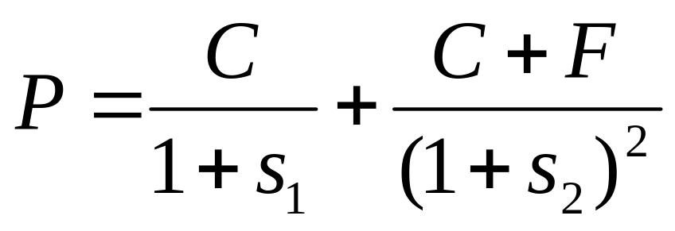
Determining the spot rate
The spot rate curve can be determined from the prices of the coupon bearing bond by beginning with short maturities and working forward toward longer maturities
Assuming 1 year compounding convention

Slide 23
Bond Portfolio immunization
The interest rate risk from coupon paying bonds is composed of two components
1) Price Risk and 2) coupon reinvestment rate risk.

Slide 24
Immunization
The structuring of a bond portfolio to protect against interest rate risk is termed as immunization because it immunizes the portfolio value against interest rate changes.
If the duration of the portfolio matches that of the obligation stream, then the cash value of the portfolio and the present value of the obligation will respond identically to a change in yield. Specifically, if yields increase, the present value of the asset portfolio will decrease, but the present value of the obligation will decrease by approximately the same amount; so the value of the portfolio will still be adequate to cover the obligation.

Slide 25
Example
The X corporation has an obligation to pay $1 million in 10 years. It wishes to invest money now that will be sufficient to meet this obligation.
The X corporation is planning to select from three corporate bonds shown in table.
 | Rate | Maturity | Price | Yield
Bond 1 | 6% | 30 Yr | 69.04 | 9.00%
Bond 2 | 11% | 10 Yr | 113.01 | 9.00%
Bond 3 | 9% | 20 Yr | 100.00 | 9.00%

Slide 26
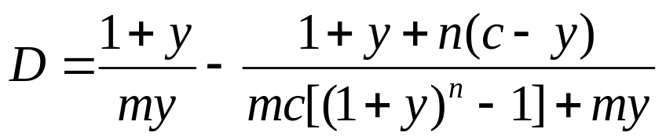
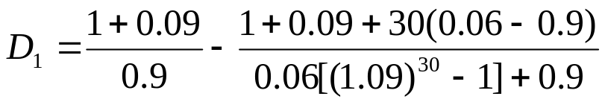
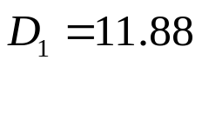
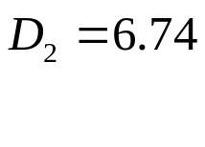
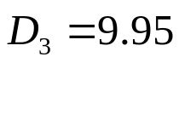
solution
First Step is to calculate the duration of Bonds.
The Macaulay duration for a bond with coupon rate c per period, Yield y per period, m periods per year, and exactly n periods remaining

Slide 27
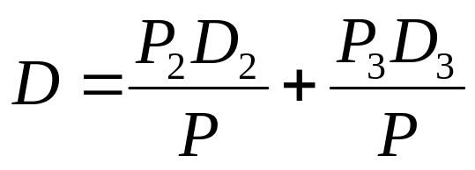
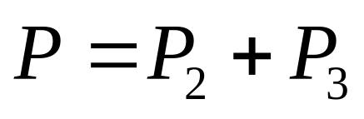
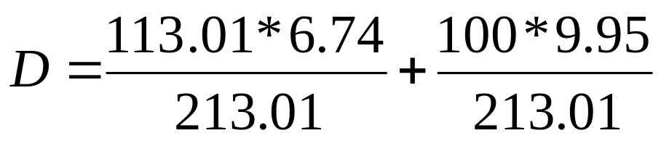
Solution
The X corporation first considers using bond 2 and 3 to construct its portfolion
The weighted Duration of Bond 2 & 3 is
The Value of D is 8.25
The duration of the obligation is 10 years and hence D < 10 Years.
A Bond with longer duration is required

Slide 28
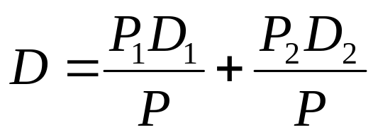
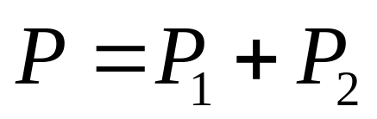
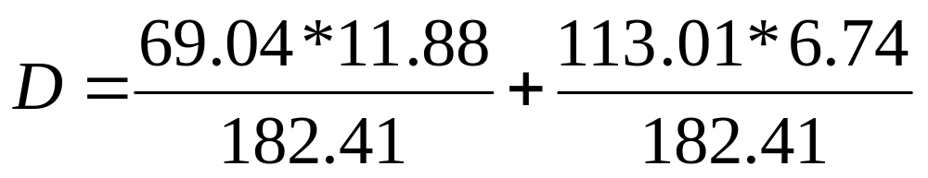
Solution
The X corporation now considers using bond 1 and 2 to construct its portfolion
The weighted Duration of Bond 1 & 2 is
The Value of D is 8.67.
A Bond with longer duration is required
Since Bond D1 >10 and hence bonds 1 & 2 will work

Slide 29
Solution
Next the present value of the obligation is computed at 9% interest.
This is PV =$414,643.
The immunized portfolio is found by solving the two equations.
V1+V2 = PV
D₁V1+ D₂V2 = 10 PV
The Solution to these equations is V₁=$292,788.73 and V₂=$121,854.27
The Number of bonds to be purchased is then found by dividing each by the respective bond price.

Slide 30
Solution
Percent Yield
9.0%
Bond1
Price 69.04
Shares 4241.00
Value 292,798.64
Bond 2
Price 113.01
Shares 1078.00
Value 121,824.78
Obligation Value 414,642.86

Slide 31
Problem
Suppose the Howell corporation must make $20 million pension fund payment each year for the next 4 years. Determine the average Macaulay duration for this four payment liability. Suppose Howell decided to immunize the payments by currently investing in zero coupon bonds with 2- year and 5 year maturities. What percent should Howell allocate to each zero coupon bond? What will be the accumulated face value of the bonds? Assume the yield curve is flat at 11%.

Slide 32
Macaulay Duration of the Payments
(1) Year | (2) Payment | (3) Present Value of (2) at 11% | (4) % of Total | (5) Payments MD (1) X (4)
1 | $20M | $18.02M | 0.29 | 0.29
2 | $20M | $16.23M | 0.29 | 0.52
3 | $20M | $14.62M | 0.24 | 0.72
4 | $20M | $13.17M | 0.21 | 0.84
 | Total | $62.04 | 1.00 | 2.37 = MD

Slide 33
To determine an Immunizing asset allocation
To determine an immunizing asset allocation, we let X equal the percent of the 2 year bonds that are needed: This implies that (1 – X) will be the percent of 5 year bonds because the two weights must sum to 1.
MD of 2 yr bonds(X) + MD of 5 yr Bonds(1-X)= 2.37 years
(2 Years)(X) + ( 5 Years)(1-X) =2.37
2 X + 5 – 5X = 2.37
X = 88% (1-X) = 12%

Slide 34
To determine an Immunizing asset allocation
The 2 Year Bonds will have a present value of 0.88 X $62.04M = $54.6M
The present value of the 5 year bonds is 0.12 X $62.04M = $7.44M.
The face value of the 2 year Bonds is $ 54.6M X (1.11)² =$67.27M
The face value of the 5 year Bonds is $7.44 X (1.11)⁵=$12.54M

Slide 35
Problem
The James Insurance company is required to pay $36,560.78 in 7 years. Show that this liability will be immunized with $20,000 of 10 year maturity 9 % coupon par value bonds, even if interest rates were to change immediately to (a) 8%, b) 10% or c) remain at 9% and stay at these assumed levels for 7 years.

Slide 36
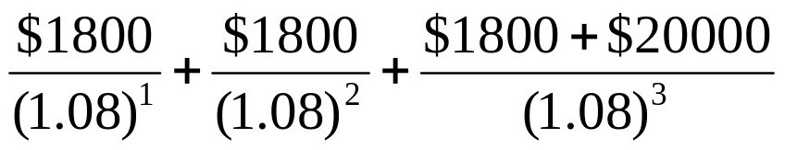
Solution
If the interest rates fall to 8 %
Fv of int. payments = total int. pay X FVA(8,7) = (.09)($20,000)X 8.9928=$16,061.04 ( I)
Bond Prices (end of Yr 7)
= $20,515.42 (II)
I + II = $36,576.46

Slide 37
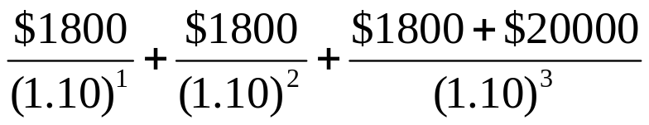
If rates rise to 10%
FV of Int Payments = Total int pay X FVA(10,7) = (.09)($20,000) x 9.4872
= $17,076.96 (III)
Bond prices( end of yr.7)=
= $19,502.62 (IV)
(III) + ( IV) = $36,579.58

Slide 38
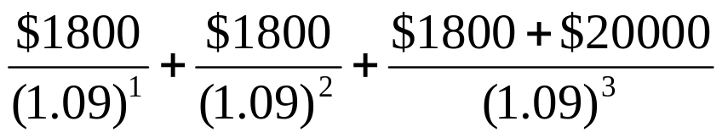
If rates remain at 9 %
FV of int. payments = total int. pay X FVA(9,7) = (.09)($20,000) X 9.2004 = $16,560.72. (V)
Bond prices( end of yr. 7) =
= $20,000 (VI)
(V) + (VI) = $36,560.72

Slide 39
Problem
You are managing a portfolio of $20M. If a target duration of 10 years has been established and you can choose from two zero coupon bonds one with 5 years to maturity and others with 20 years to maturity, what % of your portfolio should be allocated to each bond? Both bonds yield 10 %

Slide 40
Solution
If X equals the weight of 5 year bond then 1- X must be the weight for the 20 Year bond because both must sum to 1.
Since zero coupon bonds have durations equal to time to maturity
5(X) + 20 (1-X) =10

Slide 41
Solution
Refer to previous problem and its solution. What will be the face value of each bond?
The 5- year bond has a present value of
0.67 X $20M =$13.4M
The 20- year bond has a present value of 0.33 X $20M=$6.6M.
The face value of the two bonds are as follows.
(5 Yr)($13.4) x (1.10)⁵= $13.4 x 1.6105 =$21.58m
(20 Yr) ( $6.6M) X (1.10)²⁰=$6.6M x 6.7275 = $44.4M

Slide 42
Problem
Suppose the Dale Corporation must pay $25M at the end of each of the next 2 years. Bonds are yielding 12 %.
What is the present value and MD of this liability.
What maturity zero coupon bond would immunize this portfolio? Determine its face value

Slide 43
Solution
(1) Year | (2) Payment | (3) Present Value of (2) at 12% | (4) % of Total | (5) Payments MD (1) X (4)
1 | $25M | $22.32M | 0.53 | 0.53
2 | $25M | $19.93M | 0.47 | 0.94
 | Total | $42.25 | 1.00 | 1.47 years = MD

Slide 44
Solution
In order to immunize the portfolio, a 12 % zero coupon bond with a maturity of 1.47 years should be used.
The face value of the zero coupon bond is
$42.25M x (1.12)^{1.47}= $49.91M

Slide 45
Problem
Assume that the Roberts corporation must make the payments given below at the end of each of the next 5 years.
If market interest rates are 9 % over all maturities, determine the duration for this series of Liability payments.
How could this liability be immunized.
Year | Payment
1 | $10 M
2 | 9
3 | 8
4 | 8
5 | 7

Slide 46
Solution
(1) Year | (2) Payment | (3) Present Value of (2) at 9% | (4) % of Total | (5) Payments MD (1) X (4)
1 | $10M | $9.17M | 0.28 | 0.28
2 | 9M | 7.58M | 0.23 | 0.46
3 | 8M | 6.18M | 0.19 | 0.57
4 | 8M | 5.67M | 0.17 | 0.68
5 | 7M | 4.55M | 0.14 | 0.70
 | Total | $33.15 |  | 2.69 years

Slide 47
Problem
The following yield curve T bond information is given. Determine the implied forward rate for year 2
Answer: 9.0%
Years to Maturity | Yield to Maturity
1 | 7.0%
2 | 8.0%
3 | 8.5%
4 | 9.0%
6 | 10.0%
10 | 11.5%

Slide 48
Problem
The following yield curve T bond information is given. Determine the implied forward rate for year 4
Answer:10.5%
Years to Maturity | Yield to Maturity
1 | 7.0%
2 | 8.0%
3 | 8.5%
4 | 9.0%
6 | 10.0%
10 | 11.5%

Slide 49
Problem
The following yield curve T bond information is given. Determine the implied Yield on a 2 year bond at the start of year 5.
Answer:12.0 %
Years to Maturity | Yield to Maturity
1 | 7.0%
2 | 8.0%
3 | 8.5%
4 | 9.0%
6 | 10.0%
10 | 11.5%

Slide 50
Problem
The following yield curve T bond information is given. Determine the implied Yield on a 4 year bond at the start of year 7.
Answer:13.8%
Years to Maturity | Yield to Maturity
1 | 7.0%
2 | 8.0%
3 | 8.5%
4 | 9.0%
6 | 10.0%
10 | 11.5%

Slide 51
Problem
The warren Corporation has the following zero coupon bond portfolio. The current yield for each of these bonds is 10% and the yield curve is expected to remain flat.
Determine the current value of the bond portfolio.
Answer: 73.3 M
Bonds face Value | Years until maturity
$10M | 3
$20M | 4
$25M | 5
$30M | 7
$50M | 9

Slide 52
Problem
The warren Corporation has the following zero coupon bond portfolio. The current yield for each of these bonds is 10% and the yield curve is expected to remain flat.
What is the weighted average duration for the bond portfolio
Answer: 6.2 years
Bonds face Value | Years until maturity
$10M | 3
$20M | 4
$25M | 5
$30M | 7
$50M | 9

Slide 53
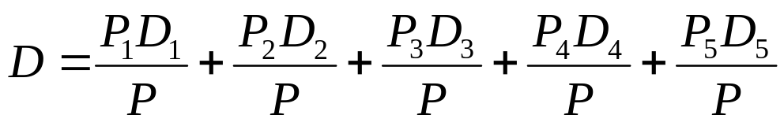
Solution
Weighted Average duration for the bond portfolio is Given by
Since it is a zero coupon bond the duration of the bond is equal to its time maturity.

